Slide 1
MOBILE NETWORK ACCESS DEVICE FOR USE WITH THE DHS ADVANCED CONTAINER SECURITY SYSTEM
Sergio Enriquez

Slide 2
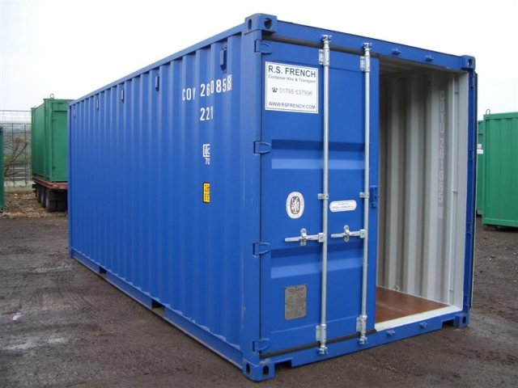
The problem

Slide 3
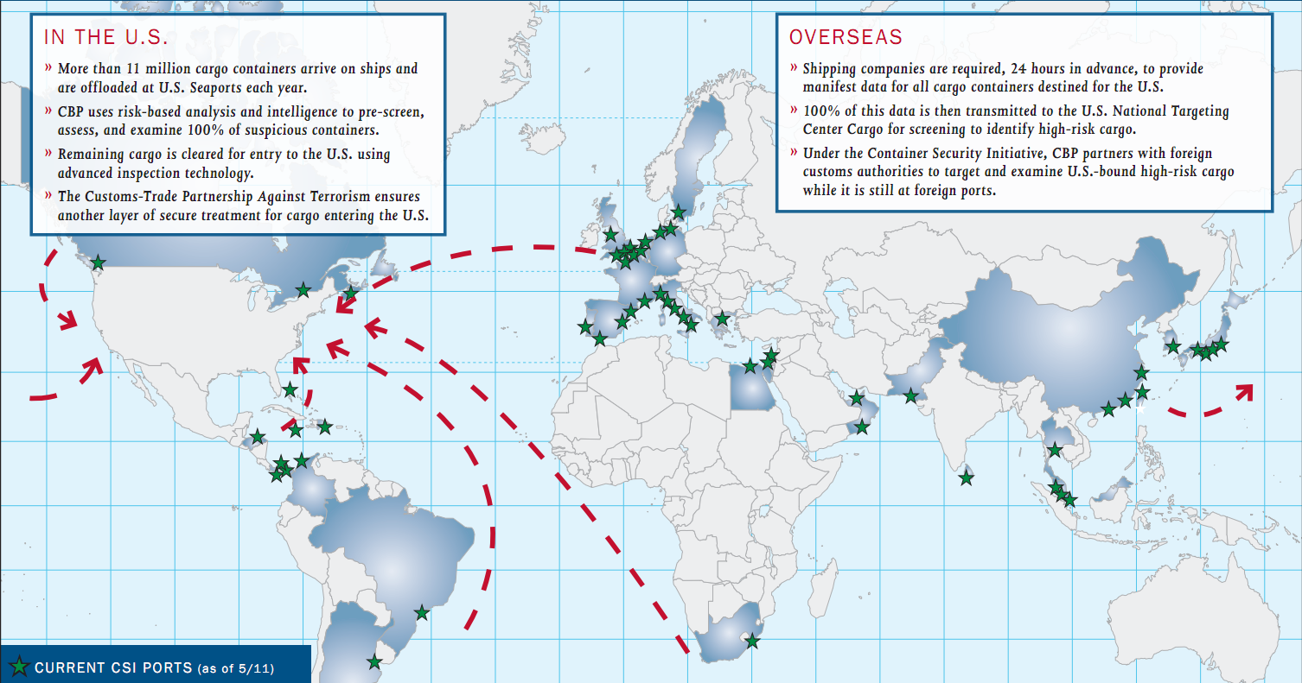
Cargo Security Initiative

Slide 4
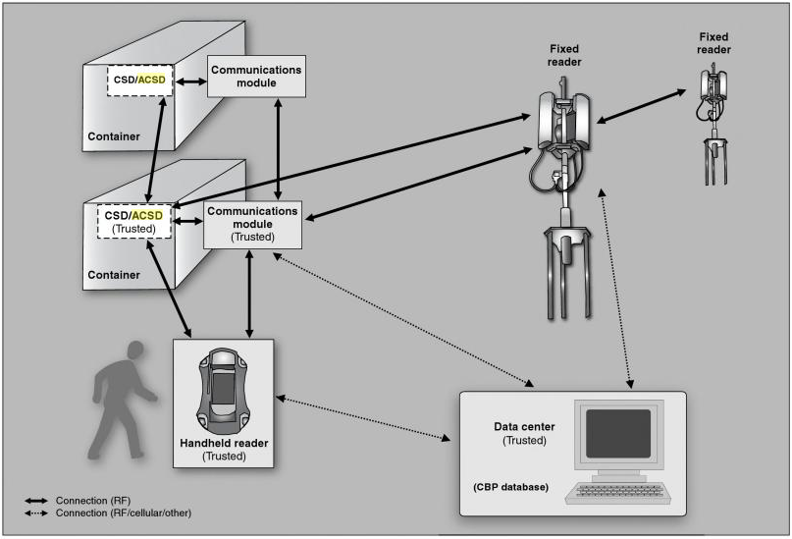
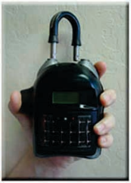
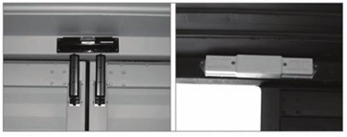
Cargo Security Test Program

Slide 5
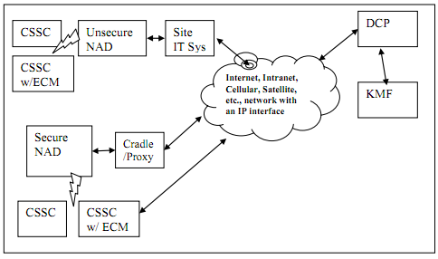
System Components

Slide 6
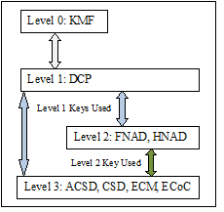
ICD Security Overview

Slide 7
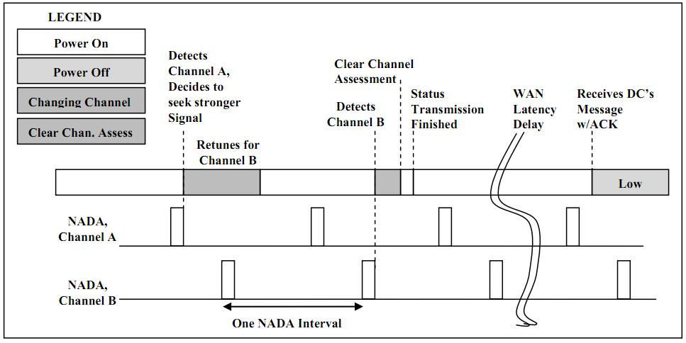
Network Detection

Slide 8
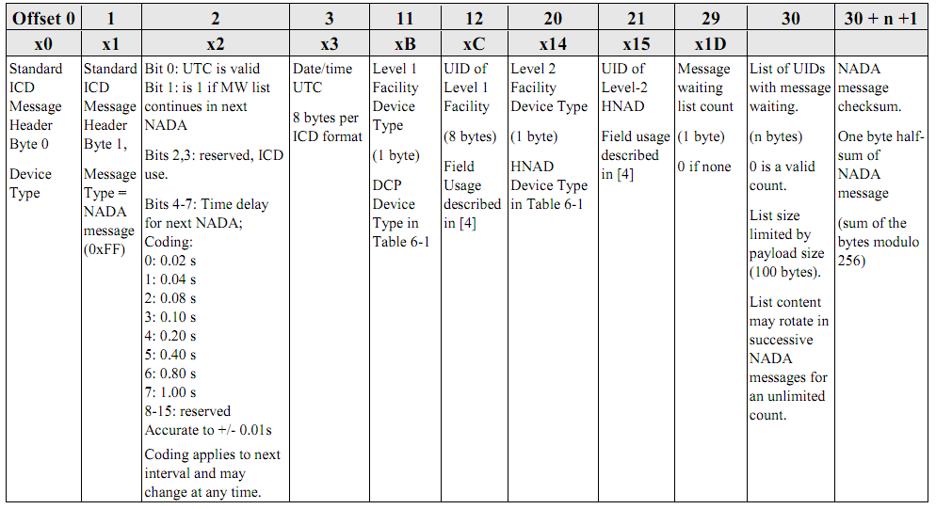
NADA Message

Slide 9
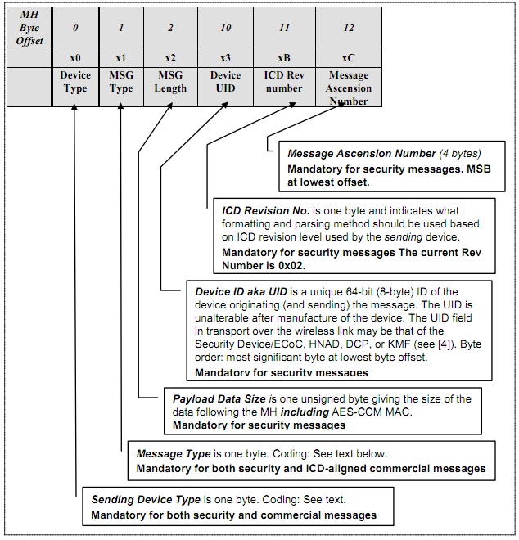
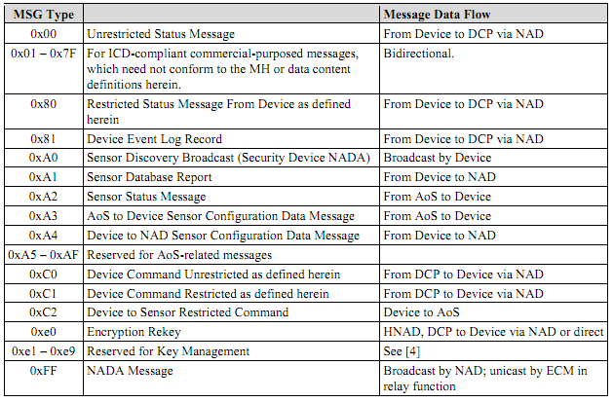
ICD Packet Format

Slide 10
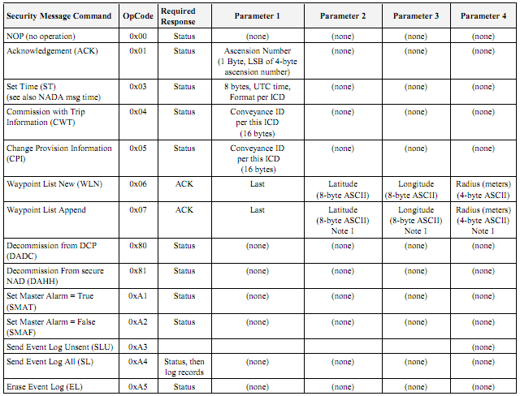
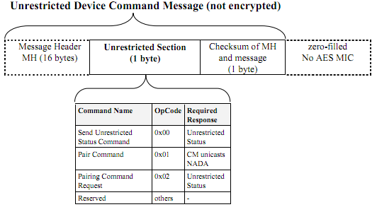
ICD Commands

Slide 11
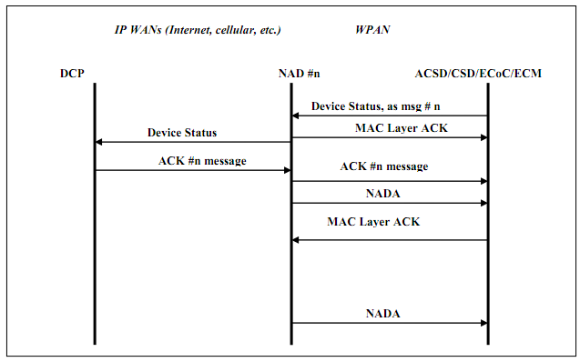
Unrequested Status Message

Slide 12
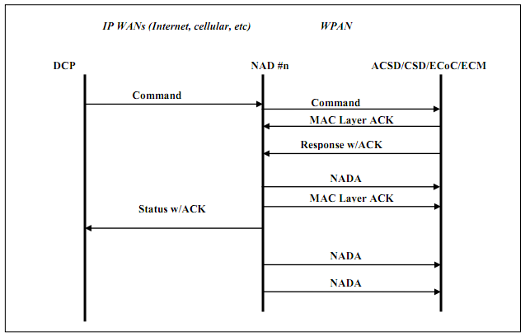
Command Message

Slide 13
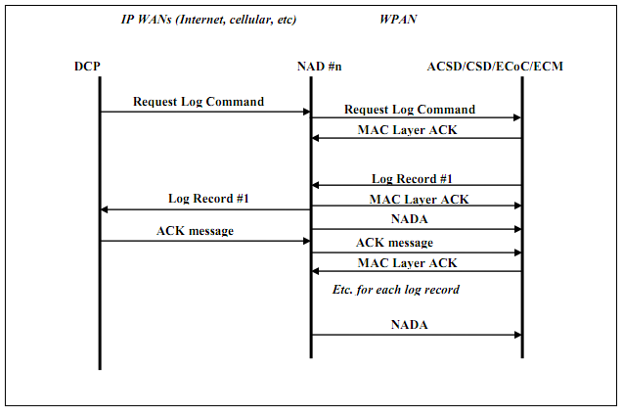
Log Message

Slide 14
ICD Network Communication

Slide 15
ICD Network Packet Format
Field | Size (bytes) | Purpose
Revision | 1 | ICD revision used by source
Function Code | 1 | Identifies the payload type of this message
UID | 8 | Unique ID of the device transmitting this message
Payload | Varies | Content of this message
Code | Type
0 | Heartbeat
1 | Heartbeat Request
2 | ICD Content, DCP to NAD
3 | ICD Content, NAD to DCP
4 | DCP Configuration Change

Slide 16
Handheld Network Access Unit

Slide 17
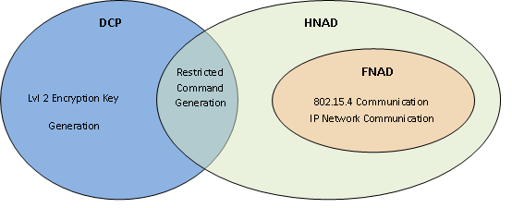
HNAD Function

Slide 18
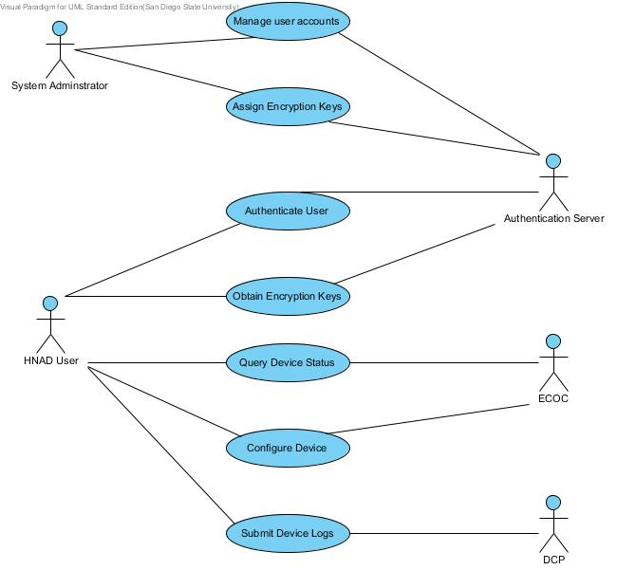
HNAD Use Cases

Slide 19
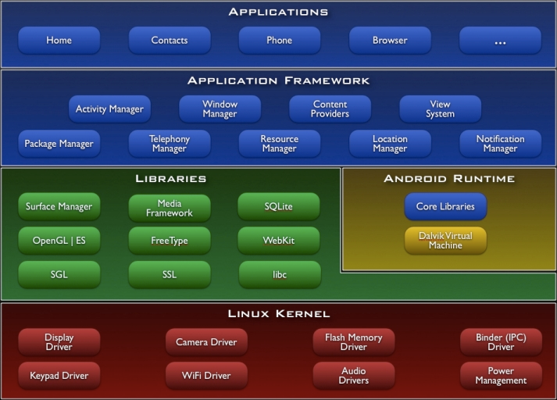
Android OS

Slide 20
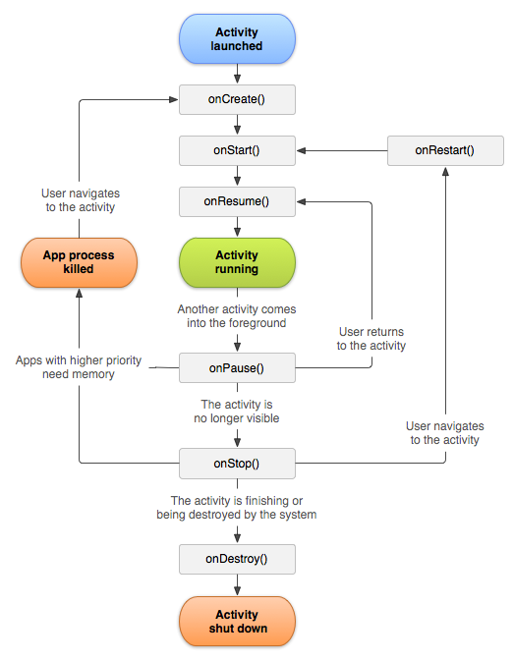
Android Activities

Slide 21
Android Services

Slide 22
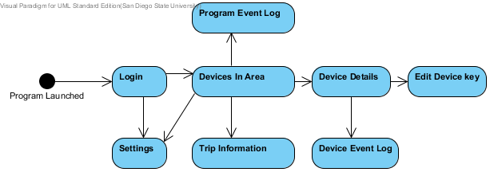
HNAD Activities

Slide 23
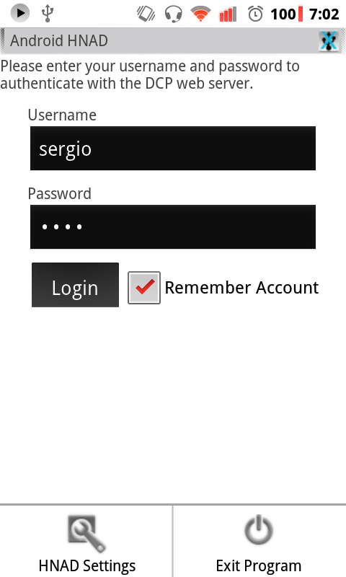
Login Activity

Slide 24
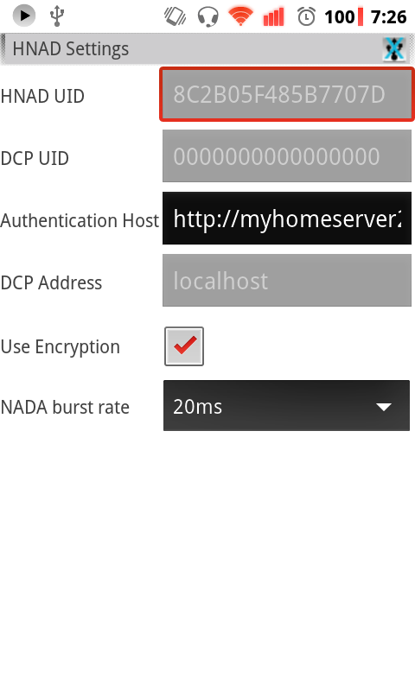
Config Activity

Slide 25
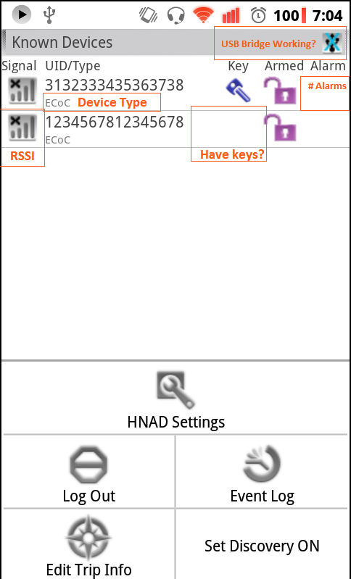
Devices in Area Activity

Slide 26
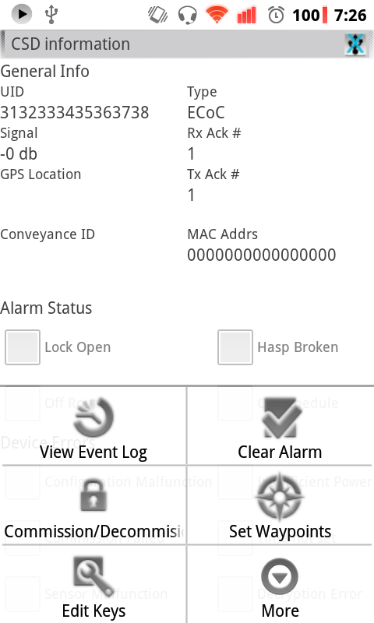
Device Details Activity

Slide 27
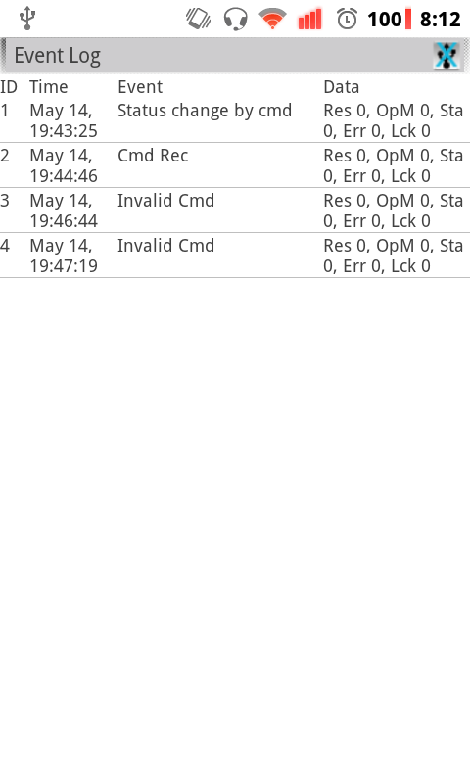
Device Log Activity

Slide 28
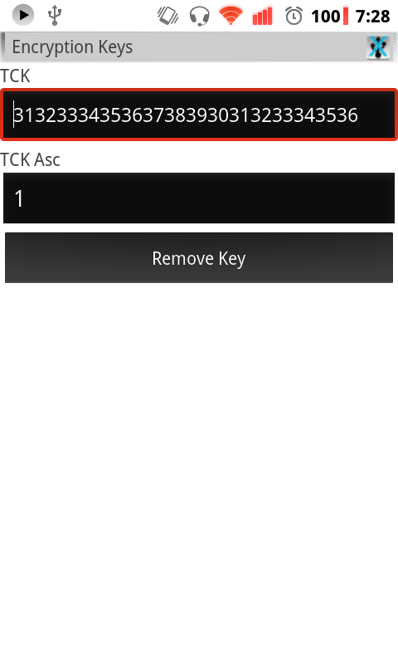
Device Key Edit Activity

Slide 29
Trip Edit Activity

Slide 30
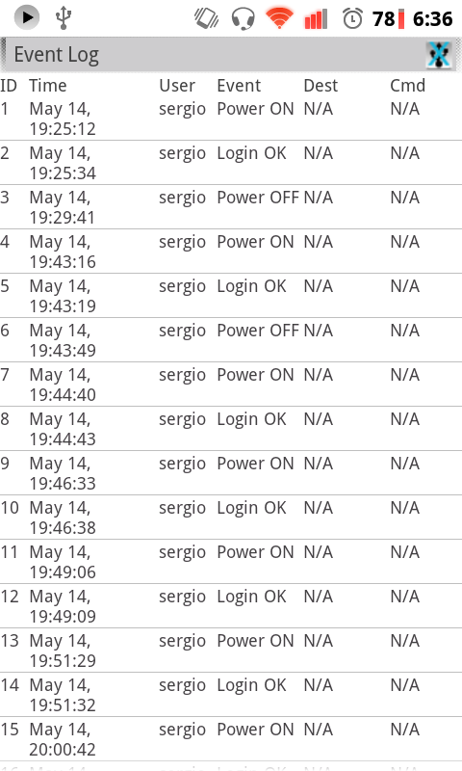
HNAD Log Activity

Slide 31
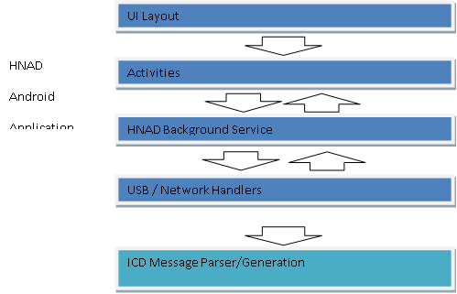
HNAD Application Organization

Slide 32
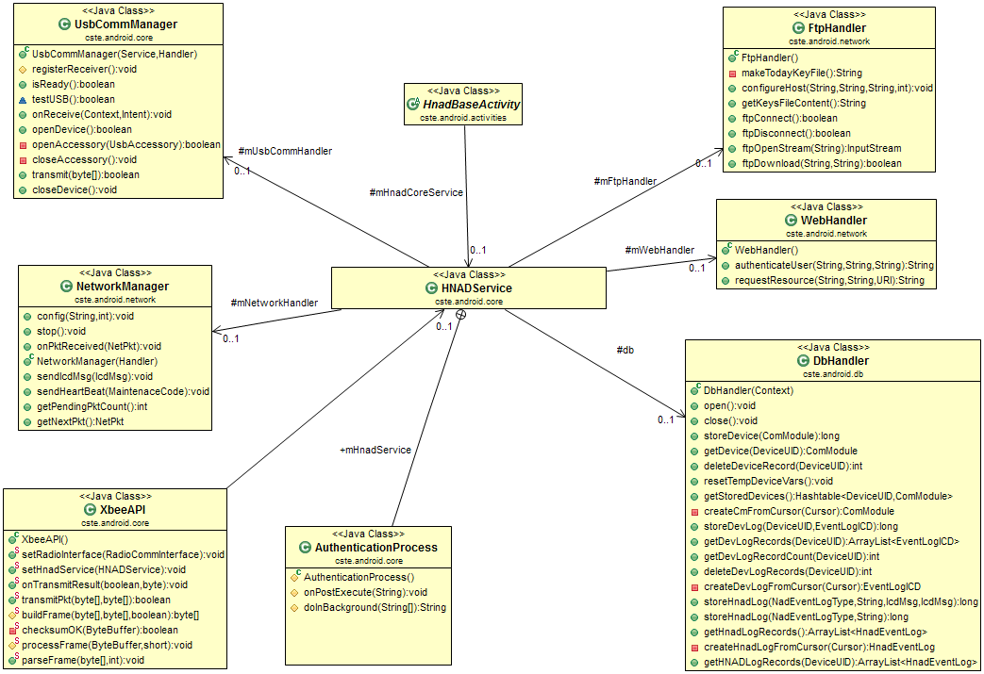
HNAD Service Components

Slide 33
HNAD Service Commands
Broadcast type | Purpose | Payload
DEVICE_INFO_CHANGED | The status or some member variable of a device has changed due to the arrival of an external message | UID of affected device
DEVLIST_CHANGED | A new device is visible, or its record has been deleted from memory. | UID of new/removed device
LOGIN_RESULT | Result of an authentication attempt | Boolean
UPLOAD_DATA | Result of submitting data to the DCP over the internet | Boolean
USB_STATE_CHANGED | USB accessory has been disconnected/ connected | Boolean
TRANSMISSION_RESULT | Result of sending data to a device on the 802.15.4 wireless network | UID of destination, Boolean
ECM_EVENTLOG_CHANGE | A new device record was added | UID of affected device, Row ID
HNAD_EVENTLOG_CHANGE | A new HNAD record was added | Row ID

Slide 34
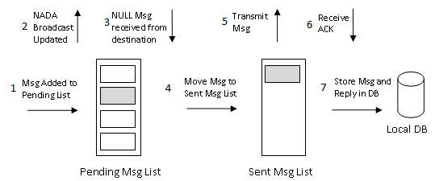
ICD Message Transmission

Slide 35
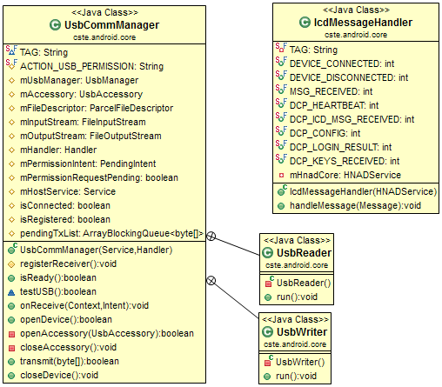
USB Process

Slide 36
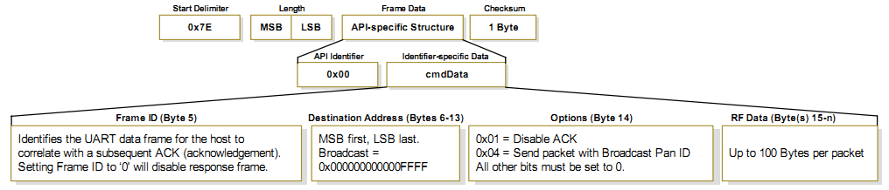
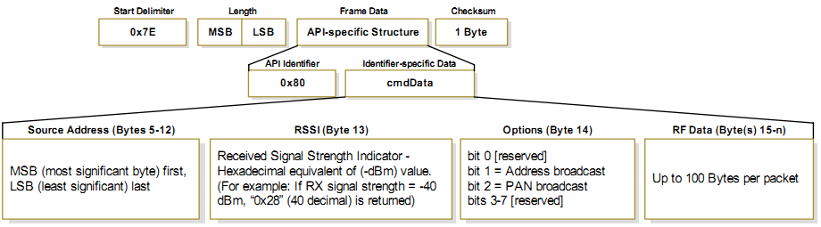
XBEE API

Slide 37
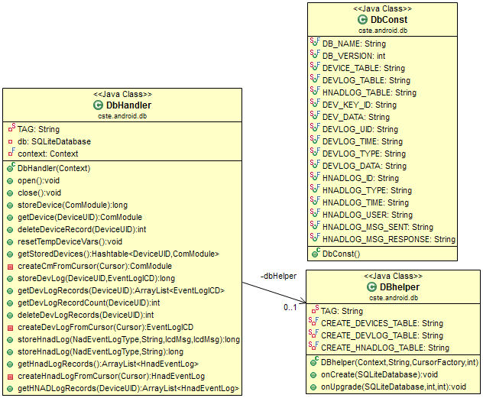
Database Handler

Slide 38
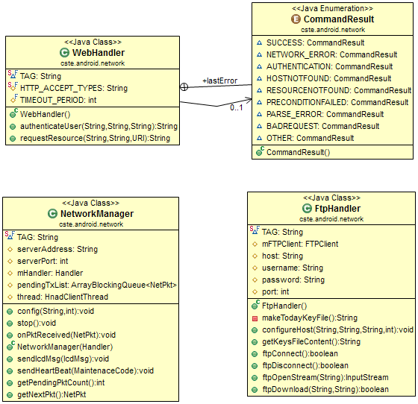
Network Communication

Slide 39
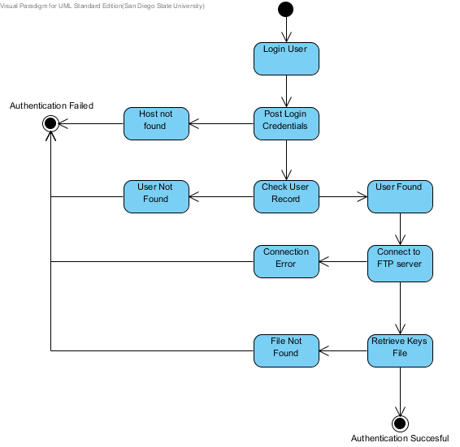
Authentication Process

Slide 40
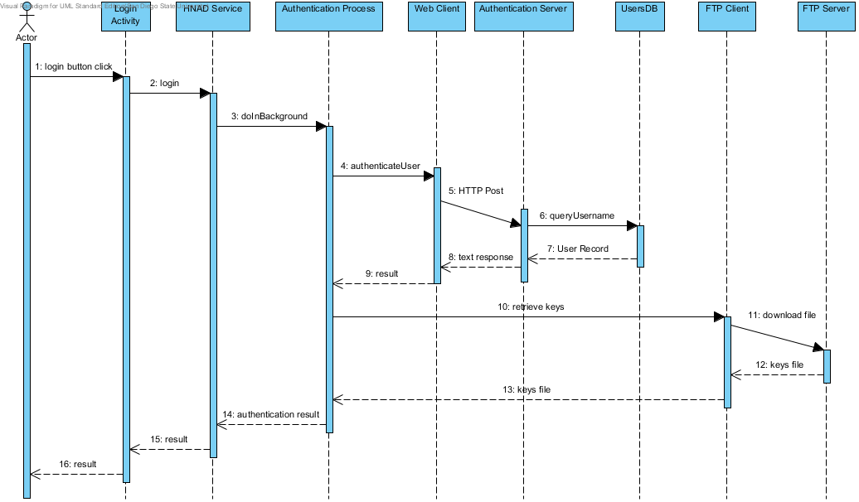
Authentication Process

Slide 41
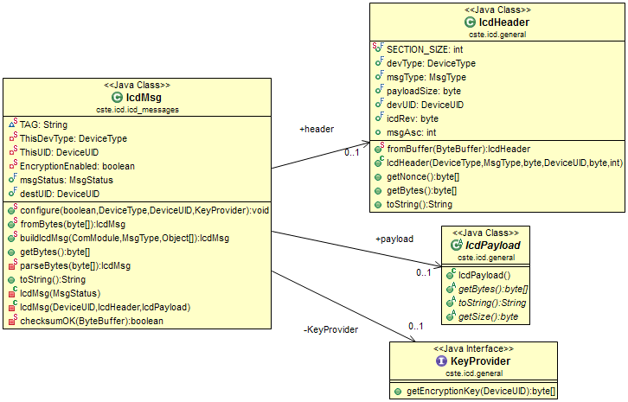
ICD Message Processing

Slide 42
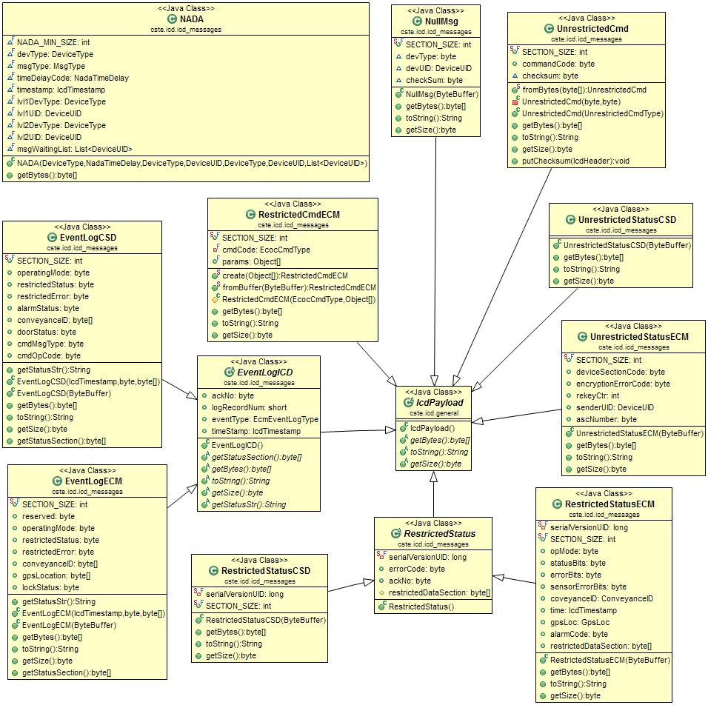
ICD Packet Payloads

Slide 43
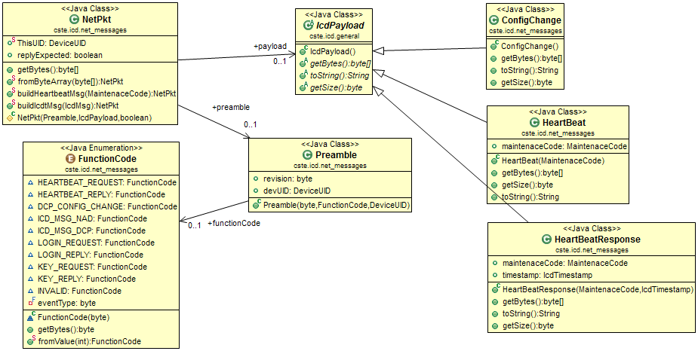
ICD IP Messages

Slide 44
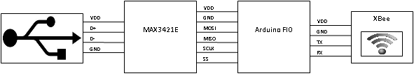
USB to XBEE Bridge

Slide 45
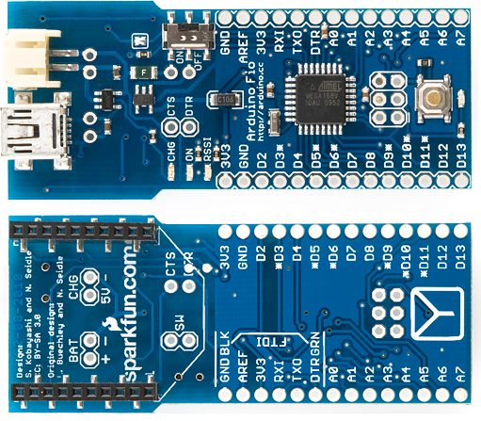
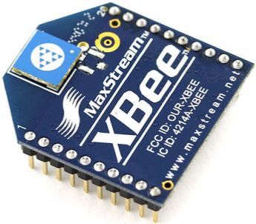
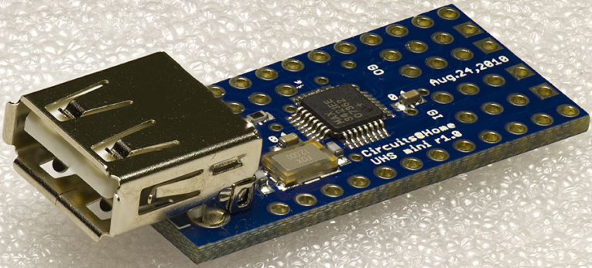
Bridge Components

Slide 46
USB Bridge Operation

Slide 47



Authentication Web Server

Slide 48
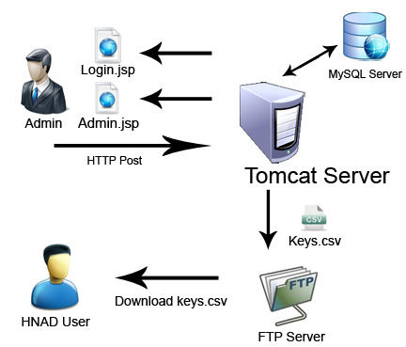
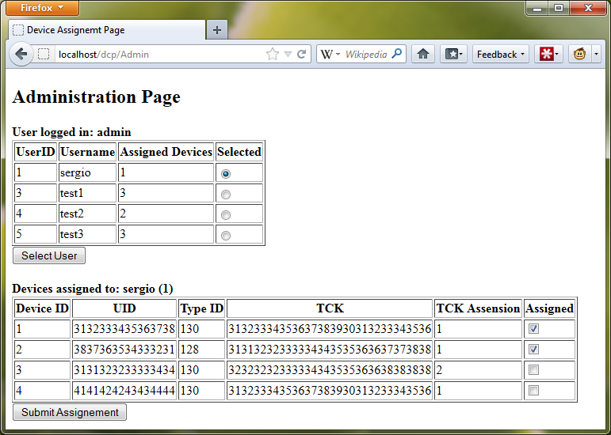
Authentication Server Operation

Slide 49

Questions

